Slide 1

Comparison of Models Forecasting Electricity Dataset
Emily, Grace, Lavina

Slide 2



Agenda
Problem and Business Value
Process and Change Management
Project Milestones and Timeline
Data Source
Baseline Models & Results
BasisFormer Model & Results
Further Model Comparison
Challenges and Future Limitations
Summary

Slide 3




Introduction
We have developed a high-precision forecasting ecosystem that leverages an ensemble of advanced models to deliver 24-hour electricity load predictions for 370 unique grid clients. By moving beyond traditional baselines towards a specialized, cluster-based architecture, this system captures complex consumption patterns with significantly higher accuracy.

Slide 4





Problem
Objective
High operational costs and grid instability caused by a "one-size-fits-all" forecasting approach that fails to capture the unique, spiky consumption patterns of diverse consumer clusters.
Deploy a cluster-optimized forecasting ecosystem to deliver 24-hour predictive intelligence while integrating an Agentic AI interface for real-time stakeholder decision-making.
From:
To:
Saved Operational Costs
Static, manual forecasting using legacy baselines like SARIMA/Prophet.
High variance in error (MAPE) during peak holidays and seasonal transitions.
Technical barriers requiring data scientists to interpret results for management.
Specialized, cluster-based modeling using a SOTA Deep Learning ensemble.
Targeted precision that identifies and adapts to unique consumer "Bases" and profiles.
Agentic workflow allowing managers to pull forecasts instantly via natural language.
Proactive Grid Stability
Strategic Resource Allocation

Slide 5
Process, Standardization and Automation
Data Processing & Clustering
Unified Training Architecture
Agentic Automation
Feature Extraction: Automated calculation of consumption profiles, including weekend/weekday ratios and seasonal strength across 370 clients
K-means Clustering: Implementation of a 4-cluster strategy to group consumers with similar “Bases” and usage patterns
Dataset Standard: Transformation of raw 15-minute readings into hourly aggregated CSVs formatted specifically for Deep Learning ingestion
Ensemble Strategy: Simultaneous training of BasisFormer, PatchTST, and Prophet models to establish a multi-tier performance baseline
Evaluation Protocol: Standardized sliding window evaluation using 0-100 MAPE to ensure cross-cluster comparability
Checkpoint Persistence: Systematically saving model weights to an organized directory for instant deployment
N8n Orchestration: Designing a low-code workflow that acts as the switchboard for all incoming manager requests
Intelligent Routing: Scripting the Agent to automatically map Consumer IDs to their corresponding cluster model without human intervention
Natural Language UX: Enables non-technical stakeholders to trigger complex 24-hour forecasting via a simple chat interface

Slide 6
Timeline
Discovery and Engineering
Baseline Development
Agentic Integration
Data Foundation
Clustering
Benchmarking
SOTA
Deployment
Advanced Analytics
Model Specialization

Slide 7
Data
Dataset: UCI Electricity Load Diagrams (2011-2014)
Resampling & Resampling: Converted 15-minute telemetry into 1-hour intervals (26,304 total rows) to focus on macro daily/weekly load cycles and reduce high-frequency noise.
Normalization: We applied StandardScaler to all 370 individual time series aggregated into 3 representative cluster profiles to ensure stable convergence across diverse client scales (residential versus commercial)
Splitting: Excluded 2011 due to data sparsity. Utilized a chronological split (Train: 2012–2013; Test: 2014) to rigorously validate the system's predictive performance on unseen future data.

Slide 8
Baseline Models

Slide 9
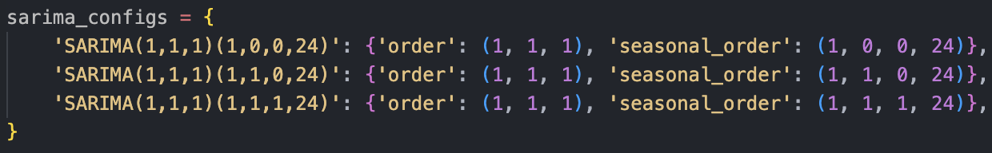
Baseline Models
Logic: Many of the future advanced and/or transformer model that we will experiment with uses channel-mixing: taking all variables a one timestamp and treating as one variable
370 clients → 1 all-encompassing client (aka 1 model for all 370 clients)
Models: We wanted to experiment with some techniques we covered in class
ARIMA
Tried the most basic model with (p,d,q)=(1,1,1)
Used auto_arima function to step search with p=1~5, q=1~5, d=0~1
SARIMA
3 different parameter settings:

Slide 10
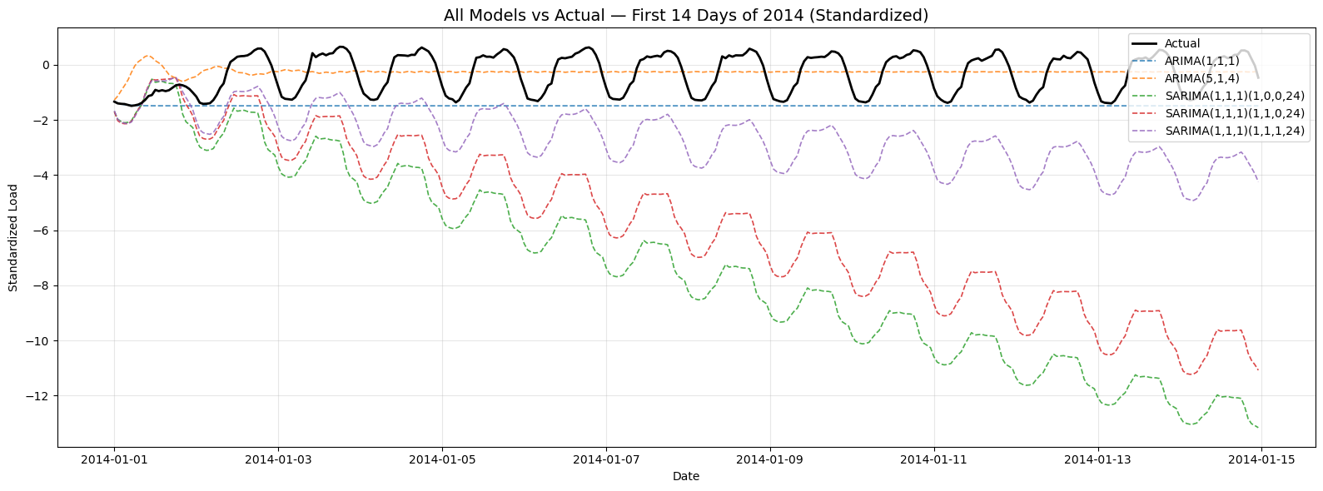
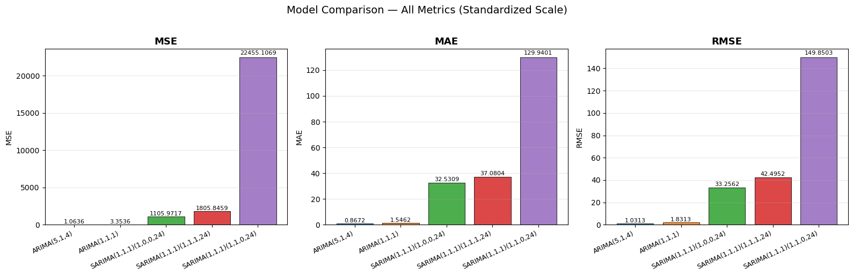
Results
ARIMA failed to capture the seasonality as expected, but stayed closed to the true values, resulting in a smaller MSE, MAE, and RMSE
SARIMA shows the general seasonal pattern of the averaged data of 370 clients, but deviated from the true value as the time progressed

Slide 11
BasisFormer

Slide 12
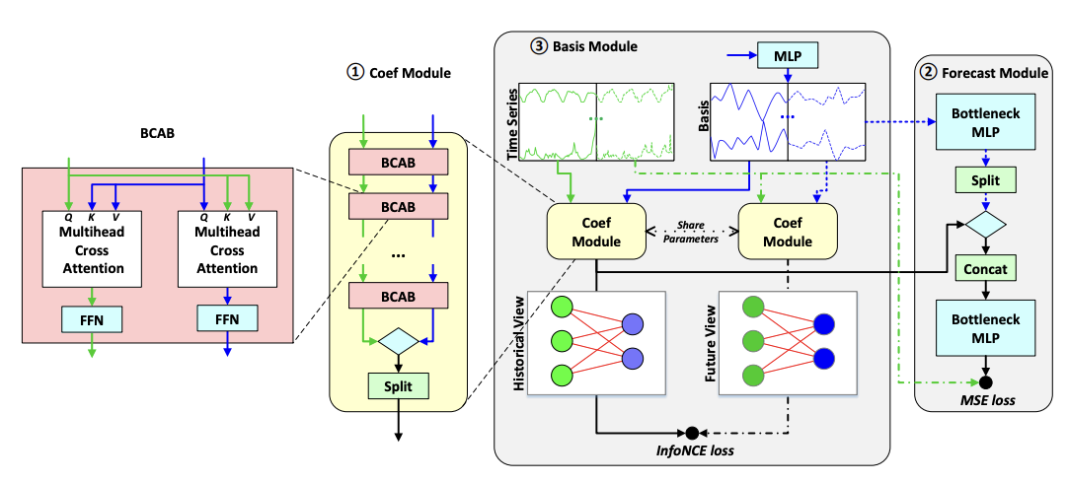
Architecture -
BCAB Block
Basis Module
A self-supervised module that learns the library of fundamental patterns (Bases) directly from the 370-client historical data
Coefficient Estimation
Instead of predicting values, the model calculates “coefficients” to determine how to mix the learned bases to match the 96-hour input window
Forecast Module:
Utilizes the learned bases and coefficients learned in the previous step to create an accurate forecast prediction perfect for the periodicity of the Electricity data

Slide 13
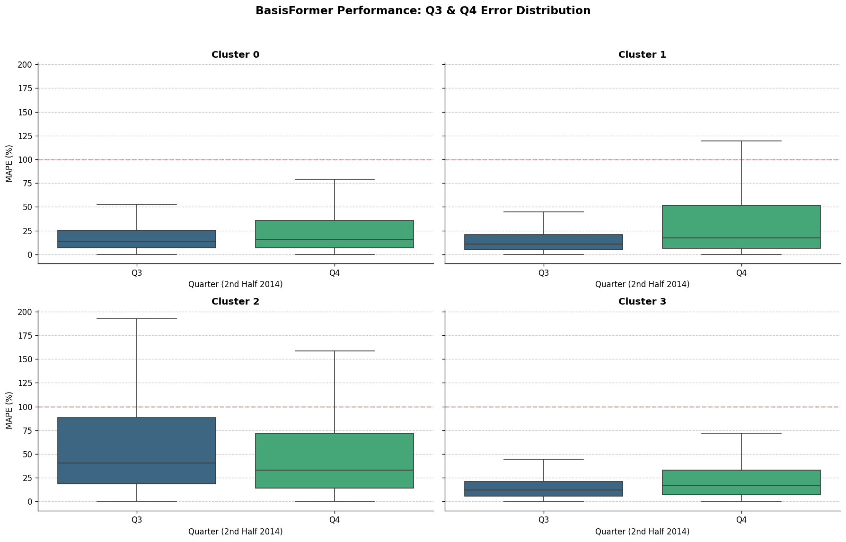
BasisFormer Results
Optimizer: Adabelief, which combines speed of Adam with generalization from SGD to stabilize the basis acquisition process
Parameters: 594,392 parameters with 10 epochs
Look-back window: 96 hour (4 days) history used to predict a 24 hour future window
Loss: Weighted sum of Prediction loss (MSE), InfoNCE Loss (representation consistency) and Smoothness Loss (erratic forecasts)

Slide 14
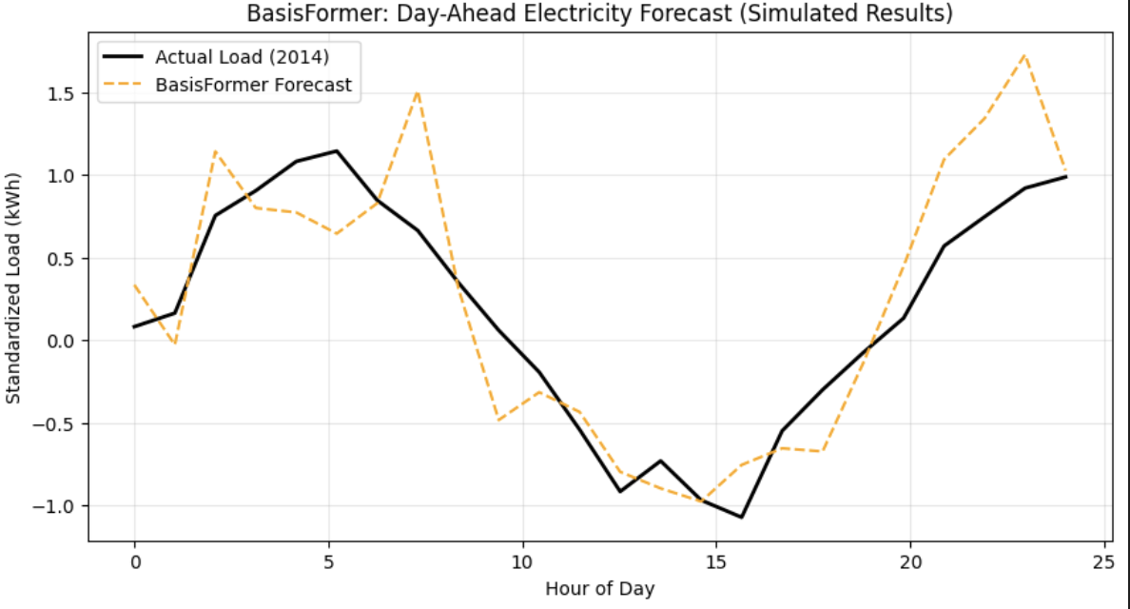
Simulated Results

Slide 15
Model Comparisons - MAPE scores
 | Seasonal Naive | SARIMA | Prophet | Basis- Former | Gradient Boost | PatchTST
Cluster 0 (Residential) | 6.41% | 29.15% | 50.26% | 171% | 4.59% | 4.49%
Cluster 1 (Industrial) | 11.16% | 45.34% | 258.94% | 107% | 8.63% | 12.18%
Cluster 2 (Mix-use) | 15.11% | 136.6% | 42.64% | 136% | 14.59% | 13.60%
Cluster 3 (Critical Infrastructure) | 117.41% | 1227.37% | 121.18% | 432% | 110.73% | 110.17%
Please see technical report for more detailed information on specific models featured here

Slide 16
Challenges & Limitations
Data & Metric Sensitivity
Model Generalization
Future Roadmap
The Challenge: High percentage errors (up to 1500%) were observed in Region 4 (Q4 2014).
The Insight: This was largely a mathematical artifact of the MAPE metric. When actual consumption drops near zero (standby power), even a physically tiny prediction error (e.g., 0.5 kWh) results in a massive percentage spike.
The Limitation: Our current models are "univariate," meaning they only see past load data and lack the context to know why a consumer suddenly went on vacation or reduced usage.
The Challenge: All models (BasisFormer, Prophet, PatchTST) showed increased variance during the November–December holiday season.
The Insight: Electricity consumption in the Portuguese grid is highly sensitive to exogenous variables like sudden temperature drops or public holiday shifts which are not captured in the raw timestamp.
The Limitation: Without Weather Data (Temperature/Humidity) or a Holiday Calendar, the models treat these spikes as "noise" rather than predictable patterns.
Feature Expansion: Integrate Weather API data and national holiday flags to stabilize Q4 predictions. Incorporate more context for better predictions and more cohesive story.
Hybrid Loss Functions: Move toward a custom loss function that penalizes large absolute errors more than percentage errors during low-load windows.
Agentic Feedback Loop: Implement a "Human-in-the-Loop" trigger in n8n that flags forecasts with high uncertainty for manual review by the grid manager.

Slide 17

Summary
This project implements a sophisticated ensemble of forecasting models to deliver precise 24-hour load predictions tailored to diverse consumer behavioral clusters. By significantly reducing predictive error in high-volatility sectors, the framework generates tangible business value through optimized energy procurement and minimized operational costs for spinning reserves. These technical insights are finalized within a front-facing, agentic AI application that transforms complex telemetry into an interactive, natural-language decision-support tool for real-time grid management.

Slide 18




Team
Emily Ramond
Name
Name
Name
Title
Title
Title

